Slide 1


P2P Network
SE3331-1 (2024 Fall)
IPADS, Shanghai Jiao Tong University
https://www.sjtu.edu.cn
xx

Slide 2
Review: DNS Hierarchy (a partial view)

Slide 3
Review: DNS Request Process
a.root.net
a.root.net
names.edu
names.edu
NS: for edu
ns.iss.edu
ns.iss.edu
NS: for
Scholarly.edu
ginger.
Scholar.edu
ginger.
Scholar.edu
ginger.
Scholar.edu
AP: for
ginger.Scholar.edu
Name client
Name client
Non-Recursion
Recursion

Slide 4
Comparing Hostname & Filename
They are both for more user friendly
File-name -> inode number
Host-name -> IP address
The file-name and host-name are hierarchical; inode num and IP addr. are plane
They are both not a part of the object
File-name is not a part of a file (stored in directory)
Host-name is not a part of a website (stored on name server)
Name and value binding
File: 1-name -> N-values (no); N-name -> 1-value (yes)
DNS: 1-name -> N-values (yes); N-name -> 1-value (yes)

Slide 5
Behind the DNS Design
Why was DNS designed in this way?

Slide 6
Benefits of Hierarchical Design
Hierarchies delegate responsibility
Each zone is only responsible for a small portion
Hierarchies also limit interaction between modules
A type of de-centralization

Slide 7
Good Points on DNS Design
Global names (assuming same root servers)
No need to specific a context
DNS has no trouble generating unique names
The name can also be user-friendly
Scalable in performance
Simplicity: look-up is simple and can be done by a PC
Caching: reduce number of total queries
Delegation: many name severs handle lookups

Slide 8
Good Points on DNS Design
Scalable in management
Each zone makes its own policy decision on binding
Hierarchy is great here
Fault tolerant
If one name server breaks, other will still work
Duplicated name server for a same zone

Slide 9
Bad Points on DNS Design
Policy
Who should control the root zone, .com zone, etc.? Governments?
Significant load on root servers
Many DNS clients starts by talking to root server
Many queries for non-existent names, becomes a DoS attack
Security
How does a client know if the response is correct?
How does VeriSign know "change Amazon.com IP" is legal?

Slide 10
Naming Scheme
Naming: the glue of modules

Slide 11
Naming in General
ipads.se.sjtu.edu.cn – hostname
steven@apple.com - email
steven – username
EAX - x86 processor register name
main() - function name
WebBrowser - class name
/courses/cse/index.html - path name (fully-qualified)
index.html - path name (relative)
http://ipads.se.sjtu.edu.cn/courses/cse/index.html - URL
13918275839- Phone number
202.120.40.188 - IP Address

Slide 12
Naming a Disk
File name: /dev/sda1
As a special type of inode: device inode
8,0 as (major, minor)
PCI address (name): 19:00.0
SCSI storage controller: LSI Logic / Symbios Logic SAS1068E PCI-Express Fusion-MPT SAS (rev 08)

Slide 13
Naming for Modularity
Retrieval: e.g., using URL to get a web page
Sharing: e.g., passing an object reference to a function
Save space as well: only sending the name, not the object
Hiding: e.g., using a file name without knowing file system
Can support access control: use an object only if knowing its name
E.g., Windows has many undocumented API
User-friendly identifiers: e.g., “homework.txt” instead of 0x051DE540
Indirection: e.g., OS can move the location of the file data without notifying the user
Have you ever defragmented your hard driver?

Slide 14
Addresses as Names
Software uses these names in an obvious way
E.g., memory addresses
Hardware modules connected to a bus
Use bus addresses (a kind of name) for interconnection

Slide 15
Naming Schemes
A naming schemes contains three parts:
1. Set of all possible names
You cannot use ‘for’ as a variable in C
2. Set of all possible values
3. Look-up algorithm to translate a name into a value
or a set of values, or “none”

Slide 16
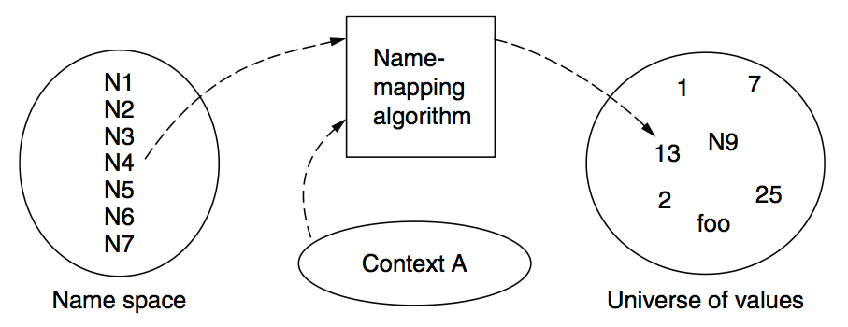
Naming Model

Slide 17
Naming Terminology
Binding – A mapping from a name to value
Unbind is to delete the mapping
A name that has a mapping is bound
A name mapping algorithm resolves a name

Slide 18
Naming Context
Type-1: context and name are separated
E.g., inode number’s context is the file system
Type-2: context is part of the name
E.g., xiayubin@sjtu.edu.cn
Name spaces with only one possible context are called universal name spaces
Example: credit card number, UUID, email address

Slide 19
Determining Context - 1
Hard code it in the resolver
Examples: Many universal name spaces work this way
Embedded in name itself
cse@sjtu.edu.cn:
Name = “cse”
Context = “sjtu.edu.cn”
/ipads.se.sjtu.edu.cn/courses/cse/README :
Name = “README”
Context = “/ipads.se.sjtu.edu.cn/courses/cse”

Slide 20
Determining Context - 2
Taken from environment (Dynamic)
Unix cmd: “rm foo”:
Name = “foo”, context is current dir
Question: how to find the binary of “rm” command?
Read memory 0x7c911109:
Name = “0x7c911109”,
Context is thread’s address space
Many errors in systems due to using wrong context

Slide 21
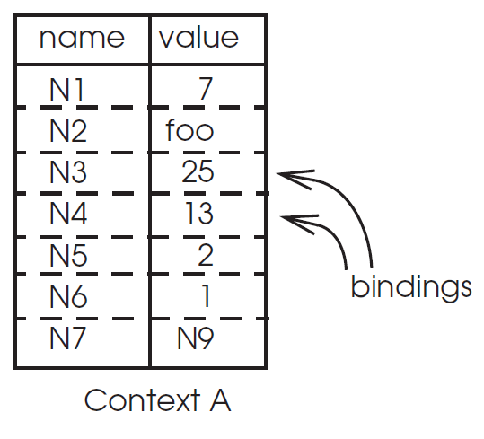
Name Mapping Algorithms - 1
Table lookup
Find name in a table
E.g., Phone book
Context: which table?
Implicit VS. explicit
Default context

Slide 22
Name Mapping Algorithms - 2
Recursive lookup
E.g., “/usr/bin/rm”
First find “usr” in “/”, then find “bin” in “/usr”, then “rm”
Each look-up process is the same
Multiple lookup
Recall: how to find “rm” without absolute name?
$PATH
E.g., “/usr/local/sbin:/usr/local/bin:/usr/sbin:/usr/bin:/sbin:/bin”
Look-up in a predefined list of context

Slide 23
Interpreter Naming API
value ← RESOLVE(name, context)
Return the mapping of name in the context
status ← BIND(name, value, context)
Establish a name to value mapping in the context
status ← UNBIND(name, context)
Delete name from context
list ← ENUMERATE(context)
Return a list of all bindings
result ← COMPARE(name1, name2)
Check if name1 and name2 are equal

Slide 24
FAQ of Naming Scheme - 1
What is the syntax of names?
What are the possible value?
What context is used to resolve names?
Who specifies the context?
Is a particular name global (context-free) or local?

Slide 25
FAQ of Naming Scheme - 2
Does every name have a value?
Or, can you have “dangling” names? (a name without any value)
Can a single name have multiple values?
Does every value have a name?
Or, can you name everything?
Can a single value have multiple names?
Or, are there synonyms?
Can the value corresponding to a name change over time?

Slide 26
Content Distribution
Files on the Internet

Slide 27
Content Distribution
How to reduce load latency over Internet?
Especially for large files, e.g., images and videos
Client side
Many people from SJTU might access same web pages
Save bandwidth by caching a local copy
Server side
Not all clients use cache
Push data out to content distribution network (CDN)

Slide 28
Caching Examples
Web browser caches recently accessed files
E.g., allow "back" button to operate more efficiently
Web proxies cache recently accessed URLs
Save bandwidth/time when multiple people locally access same remote URL
DNS resolvers cache resource records (URL→IP)
NFS clients cache read/written data

Slide 29
Content Distribution Network (CDN)
Network of computers that replicate content across the Internet
Bringing content closer to requests
End users only use local (not shared) network capacity
Content providers actively pushes data into the network
Improve performance and reduce costs

Slide 30
Content Distribution Network (CDN)
Akamai as an example

Slide 31
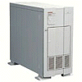

Server Selection Mechanism
Application
HTTP redirection
Advantages
Fine-grain control
Selection based on client IP address
Disadvantages
Extra round-trips for TCP connection to server
Overhead on the server
GET
Redirect
GET
OK

Slide 32
Server Selection Mechanism
Routing
Anycast routing
Advantages
No extra round trips
Route to nearby server
Disadvantages
Does not consider network or server load
Different packets may go to different servers
Used only for simple request-response apps
1.2.3.0/24
1.2.3.0/24

Slide 33
Server Selection Mechanism
Naming
DNS-based server selection
Advantages
Avoid TCP set-up delay
DNS caching reduces overhead
Relatively fine control
Disadvantage
Based on IP address of local DNS server
“Hidden load” effect
DNS TTL limits adaptation
1.2.3.4
DNS
query
1.2.3.5
local DNS server

Slide 34
How Akamai Uses DNS
34
cnn.com (content provider)
DNS root server
Akamai
cluster
Akamai global
DNS server
1
2
GET index.html
http://cache.cnn.com/foo.jpg
Akamai regional
DNS server
Nearby Akamai
cluster
End user

Slide 35
How Akamai Uses DNS
35
cnn.com (content provider)
HTTP
DNS TLD server
DNS lookup
cache.cnn.com
Akamai
cluster
Akamai global
DNS server
1
2
3
4
ALIAS:
g.akamai.net
Akamai regional
DNS server
Nearby Akamai
cluster
End user

Slide 36
How Akamai Uses DNS
36
cnn.com (content provider)
DNS TLD server
DNS lookup
g.akamai.net
Akamai
cluster
Akamai global
DNS server
5
1
2
3
4
6
Akamai regional
DNS server
ALIAS
a73.g.akamai.net
Nearby Akamai
cluster
End user

Slide 37
How Akamai Uses DNS
37
cnn.com (content provider)
DNS TLD server
Akamai
cluster
Akamai global
DNS server
5
1
2
3
4
6
Akamai regional
DNS server
7
DNS a73.g.akamai.net
8
Address
1.2.3.4
Nearby Akamai
cluster
End user

Slide 38
How Akamai Uses DNS
38
cnn.com (content provider)
DNS TLD server
Akamai
cluster
Akamai global
DNS server
5
1
2
3
4
6
Akamai regional
DNS server
7
8
9
Nearby Akamai
cluster
End user
GET /foo.jpg
Host: cache.cnn.com

Slide 39

How Akamai Uses DNS
39
cnn.com (content provider)
DNS TLD server
GET foo.jpg
11
12
Akamai
cluster
Akamai global
DNS server
5
1
2
3
4
6
Akamai regional
DNS server
7
8
9
Nearby Akamai
cluster
End user
GET /foo.jpg
Host: cache.cnn.com

Slide 40
How Akamai Uses DNS
40
cnn.com (content provider)
DNS TLD server
11
12
Akamai
cluster
Akamai global
DNS server
5
1
2
3
4
6
Akamai regional
DNS server
7
8
9
Nearby Akamai
cluster
End user
10

Slide 41
How Akamai Works: Cache Hit
41
cnn.com (content provider)
DNS TLD server
Akamai
cluster
Akamai global
DNS server
1
2
Akamai regional
DNS server
3
4
5
Nearby Akamai
cluster
End user
6

Slide 42
P2P Network

Slide 43
Downsides of Centralized Infrastructure
Centralized point of failure
High management costs
If one org has to host millions of files, etc.
Not suitable for many scenarios
E.g., cooperation between you and me
Lack ability to aggregate clients

Slide 44
P2P (Peer-to-peer): No central servers!
How to track nodes and objects in the system?
How do you find other nodes in the system?
How should data be split up between nodes?
How to prevent data from being lost?
How to keep it available?
How to provide consistency?
How to provide security? anonymity?

Slide 45
BitTorrent
Usage Model: Cooperative
User downloads file from someone using simple user interface
While downloading, BitTorrent serves file also to others
BitTorrent keeps running for a little while after download completes
3 Roles
Tracker: What peer serves which parts of a file
Seeder: Own the whole file
Peer: Turn a seeder once has 100% of a file
Notes:
** Challenges:
Tracking which peer has what
Handling high churn rates
Download rate proportional to upload rate

Slide 46
BitTorrent
Publisher a .torrent file on a Web server (e.g., suprnova.org)
URL of tracker, file name, length, SHA1s of data blocks (64-512Kbyte)
Tracker
Organizes a swarm of peers (who has what block?)
Seeder posts the URL for .torrent with tracker
Seeder must have complete copy of file
Peer asks tracker for list of peers to download from
Tracker returns list with random selection of peers
Peers contact peers to learn what parts of the file they have etc.
Download from other peers

Slide 47
A torrent file
{ 'announce': 'http://bttracker.debian.org:6969/announce',
'info': {
'name': 'debian-503-amd64-CD-1.iso',
'piece length': 262144, 'length': 678301696, 'pieces':
'841ae846bc5b6d7bd6e9aa3dd9e551559c82abc1...d14f1631d
776008f83772ee170c42411618190a4'
}
}

Slide 48
Which Piece to Download?
Different policies: Order of parts downloading
Strict?
Rarest first?
Random?
Parallel?
BitTorrent
Random for the first one
Rarest first for the rest
Parallel for the last one
Notes:
strict?
rarest first?
ensures that every piece is widely available
also helps with the seed and bootstrapping rapidly
won't retrieve the same piece multiple times from the seed
random?
avoid overloading seed when starting download
if peer has no piece, get as quickly as possible a piece so that it can upload
don't use rarest because it is likely only one peer has it
--> use random, can download subpieces in parallel
parallel download of same pieces?
avoid waiting on slowest

Slide 49
Drawback of BitTorrent
Rely on Tracker
Tracker is central component
Cannot scale to large number of torrents

Slide 50
Scalable Lookup: DHT
DHT: Distributed hash table
Used to find the node responsible for a key quickly
Distributed index: each node keeps a subset of the index
Typical DHT interface:
put(key, value)
get(key) -> value
Loose guarantees about keeping data alive
Notes:
Two options: find the data, find the node ID, who knows the data. focus on the latter.

Slide 51
P2P Implementation of DHT
Overlay Network
Partition hash table over n nodes
Not every node knows about all other n nodes
Route to find right hash table
Goals
log(n) hops
Guarantees about load balance

Slide 52
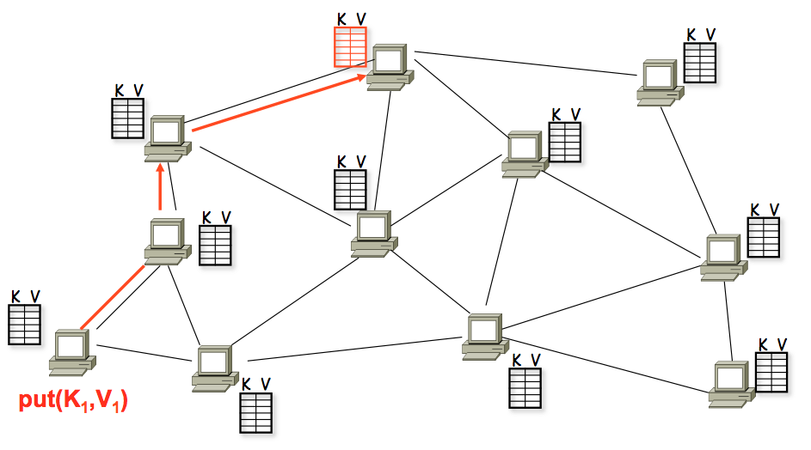
A DHT in Operation: put()

Slide 53
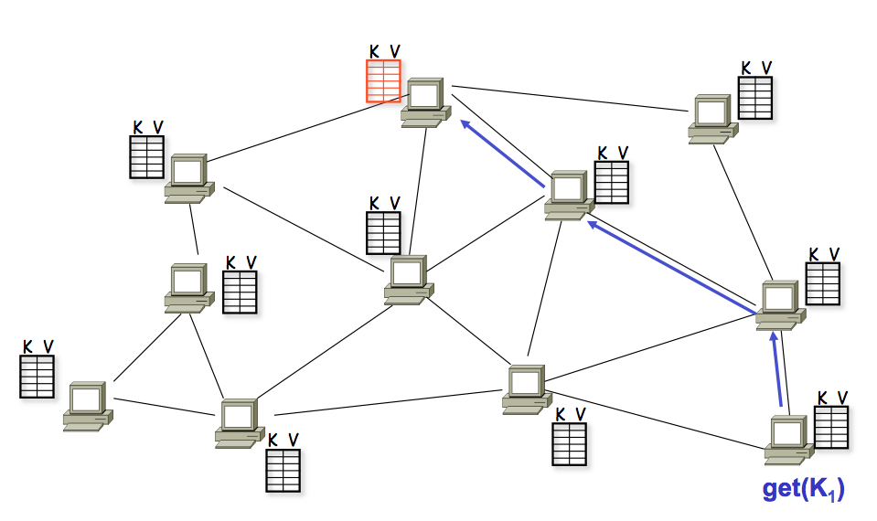
A DHT in Operation: get()

Slide 54
Chord Properties
Efficient: O(log(N)) messages per lookup
N is the total number of servers
Scalable: O(log(N)) state per node
Robust: survives massive failures

Slide 55
Chord IDs
Key identifier = SHA-1(key)
SHA-1 is a hash function
Node identifier = SHA-1(IP address)
Both are uniformly distributed
Both exist in the same ID space
How to map key IDs to node IDs? by mod?

Slide 56
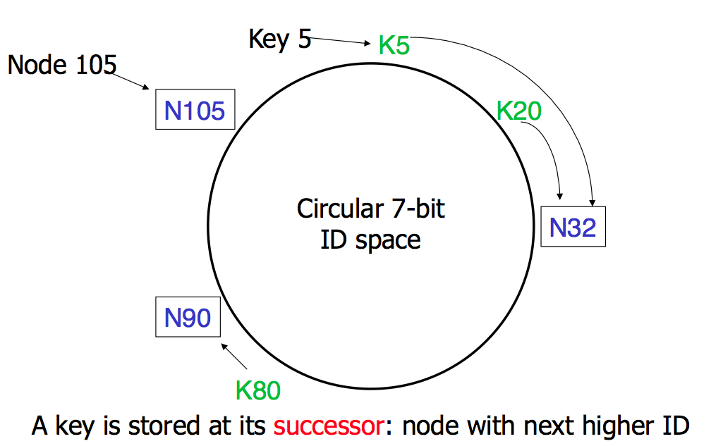
Consistent Hashing

Slide 57
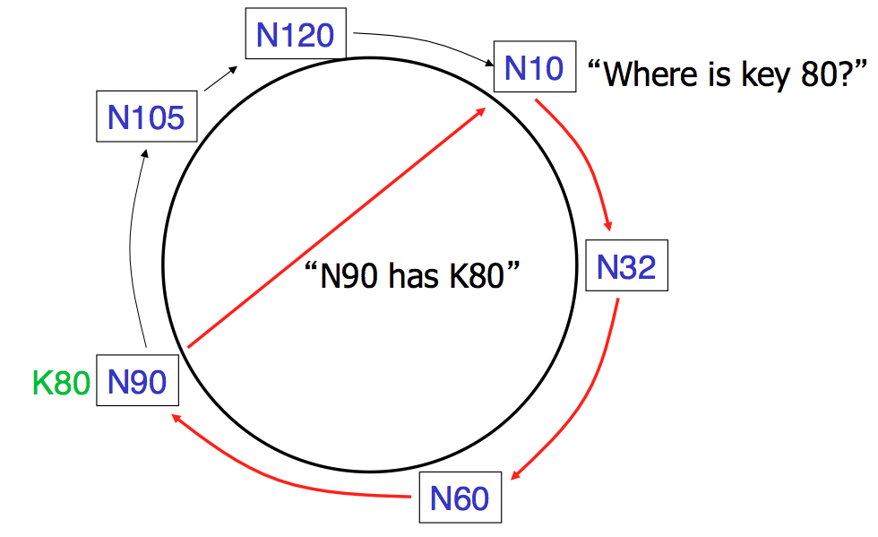
Basic Lookup

Slide 58
Simple Lookup Algorithm
Lookup(my-id, key-id)
n = my successor
if my-id < n < key-id
call Lookup(id) on node n // next hop
else
return my successor // done
Correctness depends only on successors

Slide 59
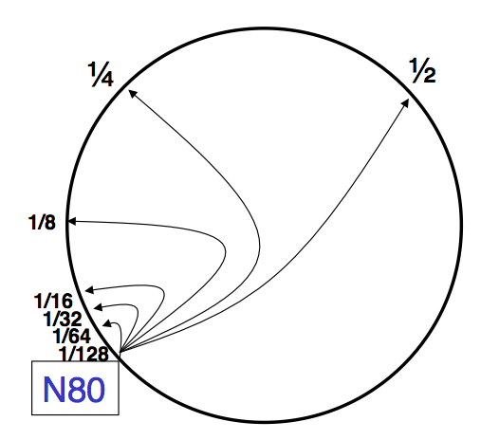
"Finger Table" allows log(N) lookups

Slide 60
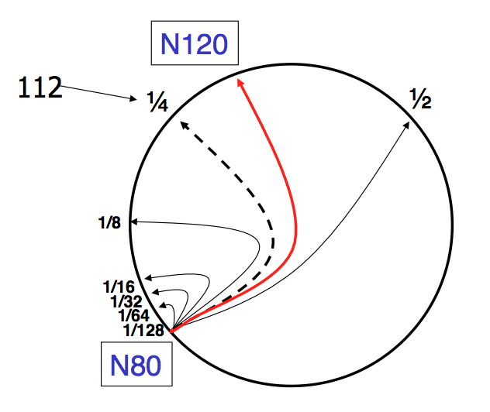
Finger i points to successor of n+2^{i}

Slide 61
Lookup with fingers
Lookup(my-id, key-id)
look in local finger table for
highest node n s.t. my-id < n < key-id
if n exists
call Lookup(id) on node n // next hop
else
return my successor // done

Slide 62
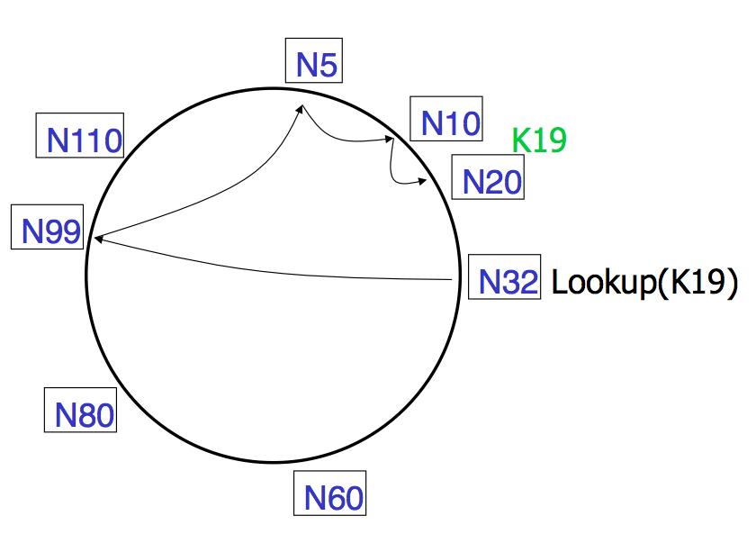
Lookups take O(log(N)) hops

Slide 63
Failures might cause incorrect lookup
N120
N10
N113
^{Lookup(90)}
N102
N85
N80
N80 doesn't know correct successor, so incorrect lookup

Slide 64
Solution: successor lists
Successor Lists
Each node knows r immediate successors
After failure, will know first live successor
Correct successors guarantee correct lookups
Guarantee is with some probability

Slide 65
Join (1)
N25
N36
1. Lookup(36)
N40
K30
K38

Slide 66
Join (2)
N25
N36
1. Lookup(36)
N40
K30
K38

Slide 67
Join (3)
N25
N36
K30
1. Lookup(36)
N40
K30
K38

Slide 68
Join (4)
N25
4. Set N25's successor pointer
N36
K30
N40
K30
K38
Update finger pointers in the background

Slide 69
Solution: successor lists
Successor List Length
Assume 1/2 of nodes fail
P(successor list all dead) = (1/2)^{r}
I.e. P(this node breaks the Chord ring)
Depends on independent failure
P(no broken nodes) = (1 – (1/2)^{r})^{N}
r = 2log(N) makes prob. = 1 – 1/N

Slide 70
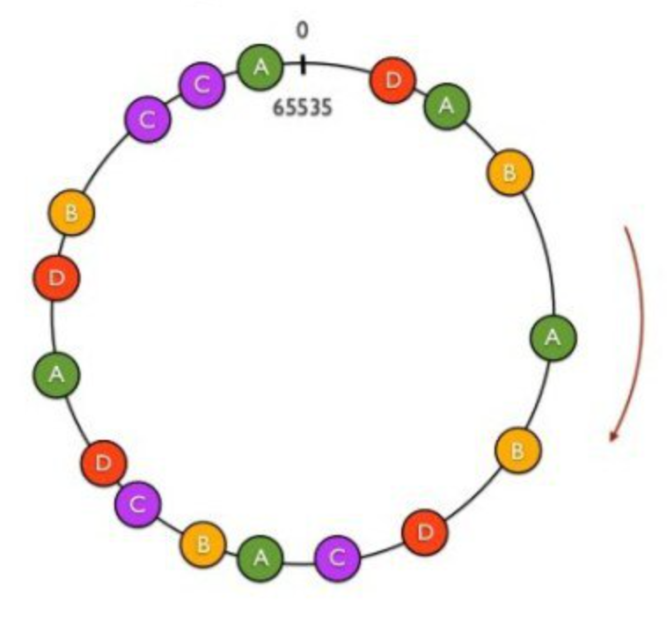
Virtual Nodes for Load Balance
Load balance could be a problem
Some nodes have most value
Solution: virtual nodes
Virtual nodes are distributed across the ring
One physical node can have multiple virtual nodes
More virtual nodes, better load balance

Slide 71
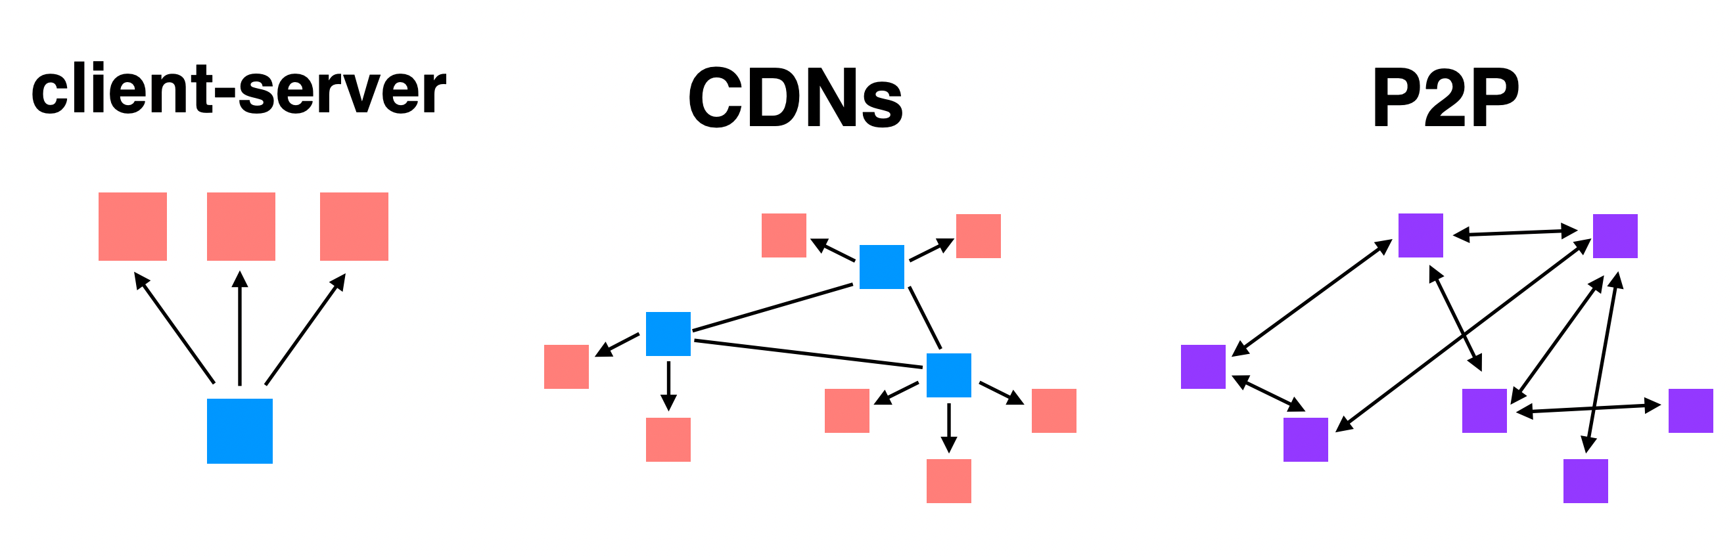
Summary: Different File Sharing Techniques

Slide 72
Bitcoin & Blockchain

Slide 73
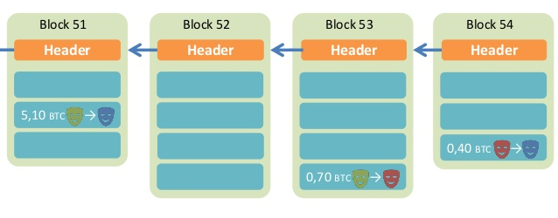
Overview of BitCoin
BitCoin is a decentralized public-accessible ledger
Using hashes as a pointers, which form a chain
Tamper-proof (assuming 51% honest)
Time

Slide 74
What is Crypto-Concurrency?
A ledger recording all the money
Why double-spending is possible?
Y creates two transactions for same coin: Y->Z, Y->Q
both with hash(T7)
Y shows different transactions to Z and Q
both transactions look good, including signatures and hash
now both Z and Q will give hamburgers to Y
How to avoid double-spending?

Slide 75
Phases in Blockchain
Proposal phase
Who to propose the block?
Validation phase
Who to validate the block?
Usually all the participants in the network
What if an attacker run multiple processes as fake nodes, in order to control 51% nodes?

Slide 76
Existing Solutions
Proof of Work (PoW)
Brute force to solve a random number (nonce)
Inefficient, waste of resources
Satisfy the number of first 0s
Tx data
Compute
the
hash
Output
Timestamp
Nonce
Nonce++
PreHash

Slide 77
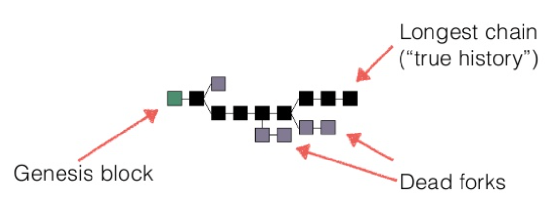
Trust the Majority
If a majority of CPU power is controlled by honest nodes, the honest chain will grow the fastest and outpace any competing chains
To modify a past block, an attacker would have to redo the proof-of-work of the block and all blocks after it and then catch up with and surpass the work of the honest nodes

Slide 78
Network Steps
1) New transactions are broadcast to all nodes.
2) Each node collects new transactions into a block.
3) Each node works on finding a difficult proof-of-work for its block.
4) When a node finds a proof-of-work, it broadcasts the block to all nodes.
5) Nodes accept the block only if all transactions in it are valid and not already spent.
6) Nodes express their acceptance of the block by working on creating the next block in the chain, using the hash of the accepted block as the previous hash.

Slide 79
Incentive
By convention, the first transaction in a block is a special transaction that starts a new coin owned by the creator of the block
The incentive can also be funded with transaction fees
The incentive may help encourage nodes to stay honest
If a greedy attacker is able to assemble more CPU power than all the honest nodes, he ought to find it more profitable to play by the rules than to undermine the system and the validity of his own wealth

Slide 80
Questions
Can some one other than the owner spend a coin?
What if I lose my private key?
Is it possible to have inflation?
Is mining really decentralized?
Is it necessary to use PoW? It's a waste of power!
How can I get bitcoin?

Slide 81
Smart Contract
The nodes not only store transactions, but also code
... and also execute the code to gen new transaction!
The code is known as "smart contract"
Execution can be triggered by events/invocations

Slide 82
Larger Storage
Store general data, instead of only transaction
Then a node needs to prove it does store the data
Proof of retrievability, in challenge-response form
Examples: IPFS, STORJ

Slide 83
Permissioned Chain
Bitcoin is a permission-less chain
Protect user's privacy by anonymity
Also hard to track
Permissioned chain is not anonymous
E.g., several companies build a chain used by themselves only
It is just a multi-manager distributed database, which has nothing new

Slide 84
It's all about Trust
Why blockchain?
We need a consensus for a ledger
There is no third party to be trusted
If there is someone trusted by all, then blockchain is not needed
Blockchain is slow and hard to use
It is designed to be that way
Considering the storage and bandwidth of the ledger

Slide 85
Questions
Why BitCoin is so valuable?
A bit-string itself does not worth anything
It is the consensus that matters
A decentralized global consensus is hard to achieve
Before BitCoin, it is even thought as impossible
BitCoin solves this problem by incentive. Human is in the loop!
How to ban BitCoin?

